Slide 1
Movie analysis
Understanding the movie industry and give insights to Microsoft on new movie creation.

Slide 2
Objective
Microsoft seeks to venture into movie/film creation industry. The goal of the project is to understand the best movie genre that will help Microsoft make informed decision on venturing into the business.

Slide 3
The project will aim to answer the following questions and give a recommendation to business about venturing into film creation.
Should Microsoft venture into film creation
What is the average runtime for a movie
What movie/film genre should Microsoft consider producing based on count.
What is the best moving genre in terms of rates and vote counts
Various data sources will be used to answer the questions above

Slide 4
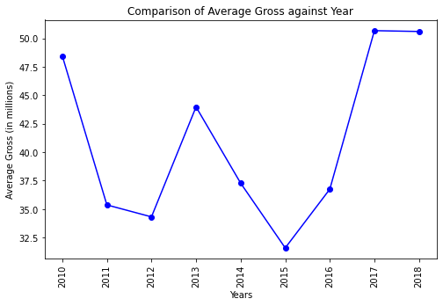
Based on these findings, it suggests that there may be an opportunity to venture into creating movies because the average gross remained stable and there is a positive trend in the preceding years (2015 to 2017).

Slide 5
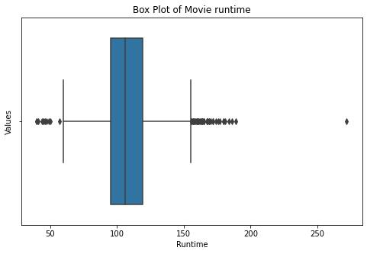
Average movie runtime
Microsoft should consider an time ranges 100-120 minutes while releasing movies as is aligns with industry standards and audience expectations.

Slide 6
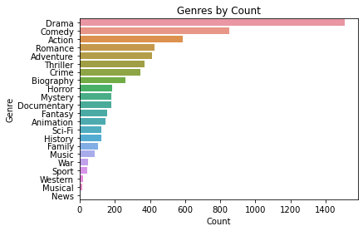
Genre by count
The top five movie genres by count based on the dataset are: Drama, comedy, action, romance and adventure.

Slide 7
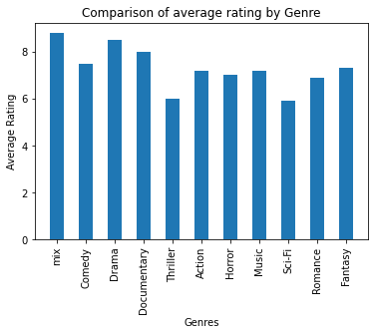
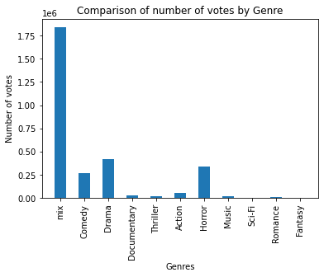
Comparison of genre by rating and number of votes

Slide 8
Recommendations
Most audience would prefer a movie that has more than one genre. It is important to note that based on the rating there is insignificant difference in the genre hence important to have a movie has a mixed genre.
Microsoft should take into consideration the runtime of a movie. The runtime of a movie can significantly impact the viewing experience and the concentration of the audience. The average movie runtime is 100-120 minutes.
Microsoft should consider creating films as income from the venture exhibit increasing and stable income over the years.In-depth market research to understand audience preferences and genre trends should be done to identify areas of opportunity and potential niches.

